Slide 1
Relational Database Design Using ER – to – Relational Mapping
Mapping of Regular Entity Types
Mapping of Weak Entity Types
Mapping of Binary 1:1 Relationship Types
Mapping of Binary 1:N Relationship Types
Mapping of Binary M:N Relationship Types
Mapping of Multivalued Attributes
Mapping of N – ary Relationship Types

Slide 2
Mapping of Regular Entity Types
For each regular(strong) entity type E in the ER schema, create a relation R that includes all simple attributes of E.
Include only the simple component attributes of a composite attribute.
Choose one of the key attributes of E as the primary key of R.
If the chosen key of E is a composite, then the set of simple attributes that form it will together form the primary key of R.
If multiple keys were identified for E during the conceptual design, the information describing the attributes that form each additional key is kept in order to specify secondary keys of relation R.

Slide 3
Mapping of Weak Entity Types
For each weak entity type W in the ER schema with owner entity type E, create a relation R and include all simple attributes of W as attributes of R.
In addition, include as foreign key attributes of R, the primary key attribute(s) of the relation(s) that correspond to the owner entity type(s).
The primary key of R is the combination of the primary key(s) of the owner(s) and the partial key of the weak entity type W, if any.
If there is a weak entity type E₂ whose owner is also a weak entity type E₁, then E₁ should be mapped before E₂ to determine its primary key first.

Slide 4
Mapping of Binary 1:1 Relationship Types
For each binary 1:1 relationship type R in ER schema, identify the relations S and T that correspond to the entity types participating in R.
There are three possible approaches:
The foreign key approach
The merged relationship approach
The cross reference or relationship relation approach

Slide 5
Mapping of Binary 1:N Relationship Types
For each regular binary 1:N relationship type R, identify the relation S that represents the participating entity type at the N – side of the relationship type.
Include as foreign key in S the primary key of relation T that represents the other entity type participating in R.
Include any simple attributes of the 1:N relationship type as attributes of S.

Slide 6
Mapping of Binary M:N Relationship Types
For each binary M:N relationship type R, create a new relation S to represent R.
Include as foreign key attributes in S the primary keys of the relations that represent the participating entity types.
Their combination will form the primary key of S.
Also include any simple attributes of the M:N relationship type as attributes of S.

Slide 7
Mapping of Multivalued Attributes
For each Multivalued attribute A, create a new relation R.
This relation R will include an attribute corresponding to A, plus the primary key attribute K – as foreign key in R – of the relation that represents the entity type or the relationship type that has A as an attribute.
The primary key of R is the combination of A and K.

Slide 8
Mapping of N – ary Relationship Types
For each N – ary relationship type R, where n>2, create a new relation S to represent R.
Include as foreign key attributes in S the primary keys of the relations that represent the participating entity types.
Also include any simple attributes of the n – ary relationship type as attributes of S.
The primary key of S is usually a combination of all the foreign keys that reference the relations representing the participating entity types.

Slide 9
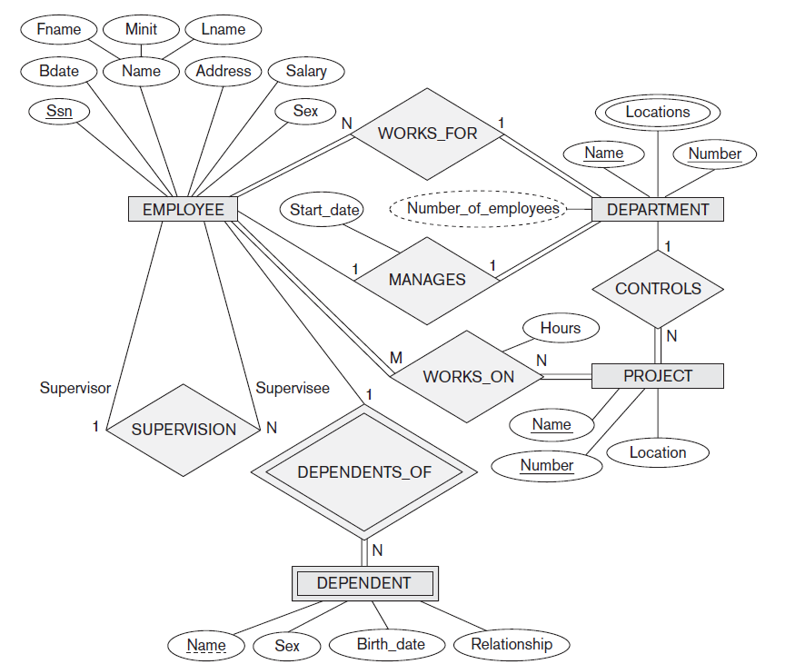

Slide 10
